Slide 1
Williams Middle Magnet
Slideshow
by Annissa
Desamour

Slide 2
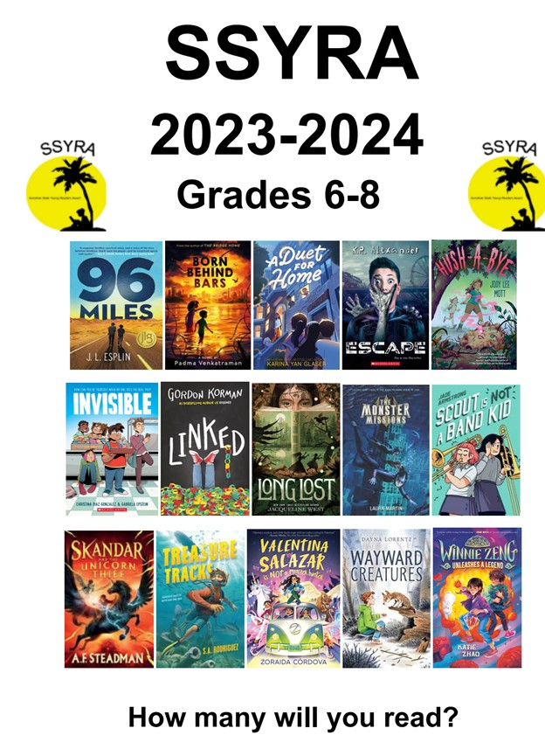

Slide 3
Video #1

